Slide 1
Traffic Control Management System
Subject:-object oriented programming
& methodology (cs-305)
presented by:
mohit gupta
Rohit sahu
Nandini soni
Pranjal guptA

Slide 2
INRTODUCTION :
Traffic Control Management System is the design and implementation of traffic control plans at worksites and civil infrastructure projects. Traffic Management can include: full freeway closures, pedestrian access, traffic plans, traffic management vehicles and manage vehicles database .
We Chose this project because In government sectors ,Traffic is the only field which is not grow technically by time like any other fields such as Railway ,police , banking etc . And we have to do something in Government sectors.
The main purpose of this program to contain the recods and information of all types of vehicles in sequencial database form . And use this data to get information about those vehicles which is used to be located on various purposes. This program contain some additional data which is very useful in emergency and non-emergency situations.

Slide 3
INDEX :
Class 1:Display
Class 2:Functions
Vehicle menu
Class 3:Vehicles
Add record
Password
Loading
menu
Booths
Helpline
control
Store record
Show record
Update record
Search record
Display record
Delete record

Slide 4
Explaination of Basic Infrastructure:
Basic Infrastructure of this Program is devided into three parts :-
Class 1:Display - Display is the first and very important class of this program . which contains three member functions.
Class 2:Functions - Functions is the second class of this program which . Contains four member functions .
Class 3:Vehicles - Vehicles is the third class of this program which contains . Seven member functions.

Slide 5
Class 1 : Display
Password :- Password is first member function of this class.
Loading :- Loading is second member function of this class.
Menu :- Menu is third member function of this class.

Slide 6
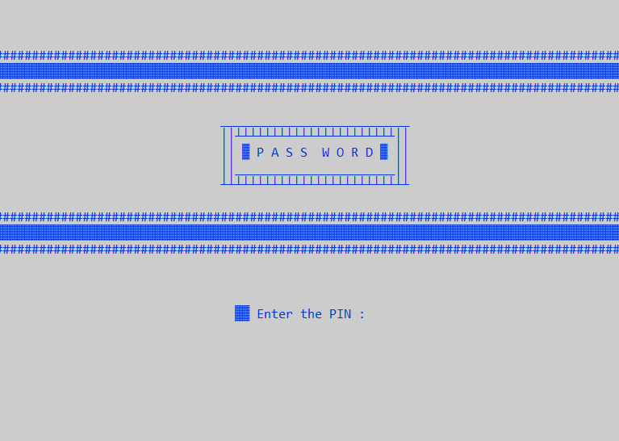
(1) Password :
Password member function is used to create for authorization purpose. So only authorized persons can acess this program .
Working:- if you password is correct you entered to the menu and if your password is wrong so you can again but there you have only 3 try to insert the password and if your all 3 try is failed and password is not matched ,So you exit to the program

Slide 7
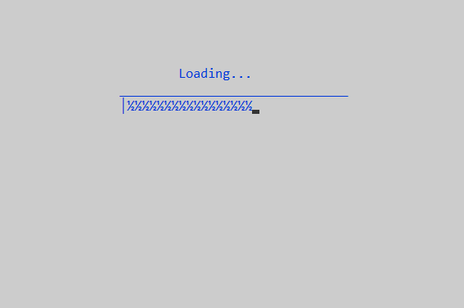
(2) Loading :
Loading is used to create a processing design ,so this program is look like more attractive than any other program .
Loading is works between the password and menu function .
Onece loading is done so you can access the menu functions according to your need .

Slide 8
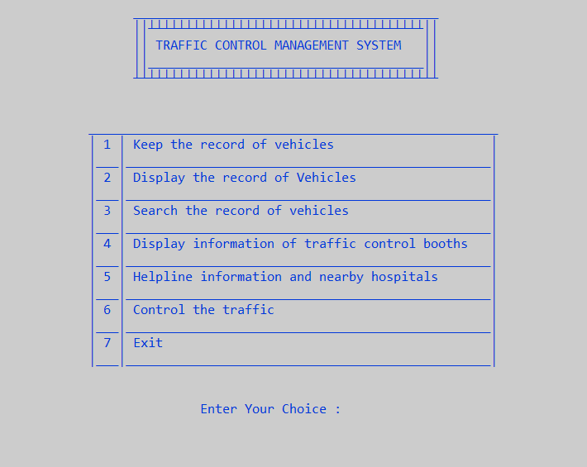
(3) Menu :
Menu is used to create a access to various options which is very helpful to manage and control the traffic according to the condition .

Slide 9
Class 2 : Functions
Vehicle menu :- Vehicle menu is the first member function of this class.
Booths :- Booths is the second member function of this class.
Helpline :- Helpline is the third member function of this class.
Control :- Control is the fourth member function of this class.

Slide 10
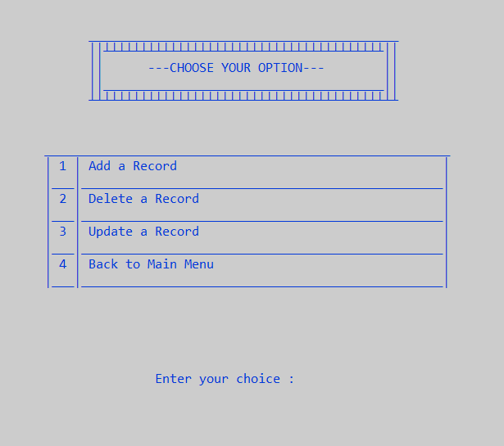
(1) Vehicle menu :
Vehicle menu is the first option of the menu of this program.
Vehicle menu is used to create a access of various other options which is used to managing the data base of all types of vehicles .
With the help of these option we can add, delete and update the records of all kind of vehicles very easily in very less time .

Slide 11
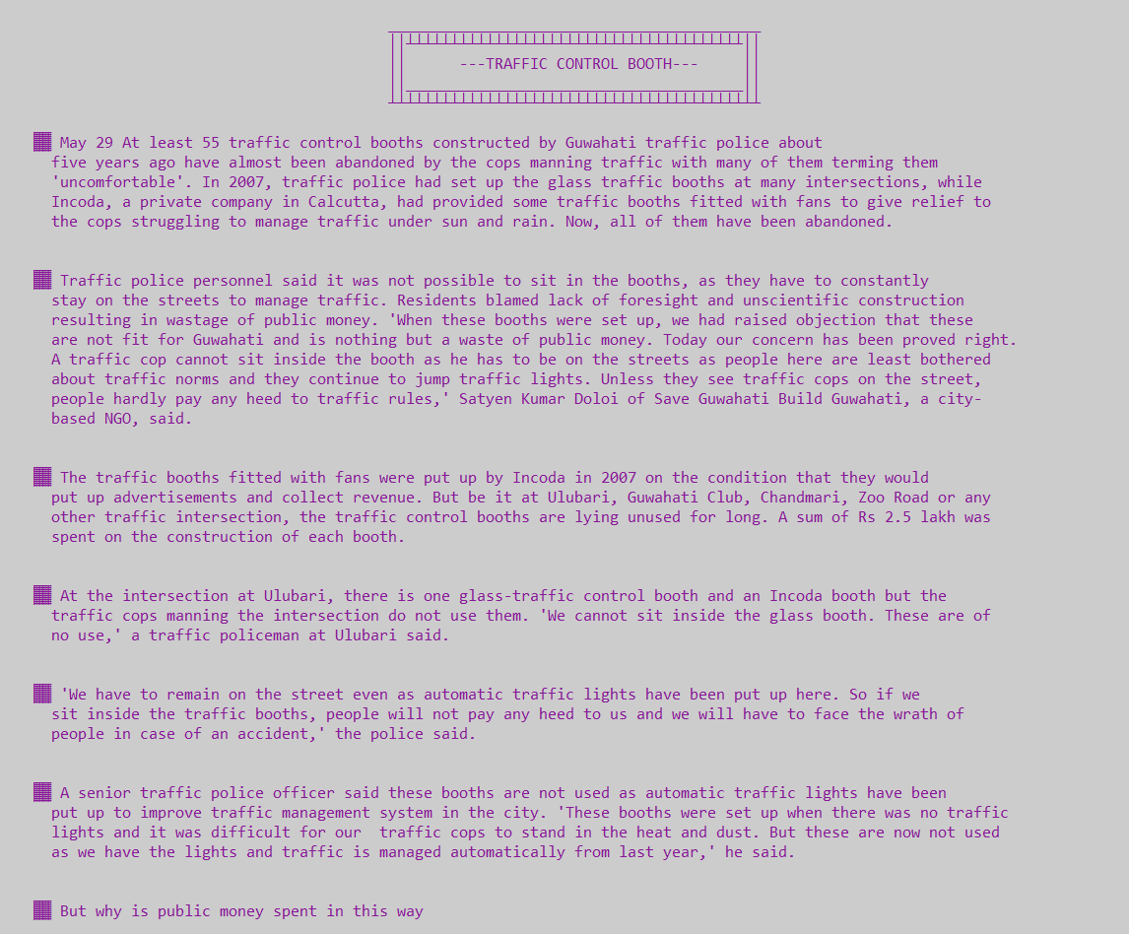
(2) Booths :
Booths is the 4 option of the menu of this program.
Booths is used to create a contain of records of accidents of various nearby traffic booths , so you can see the records of all accident which is done in our local areas.

Slide 12
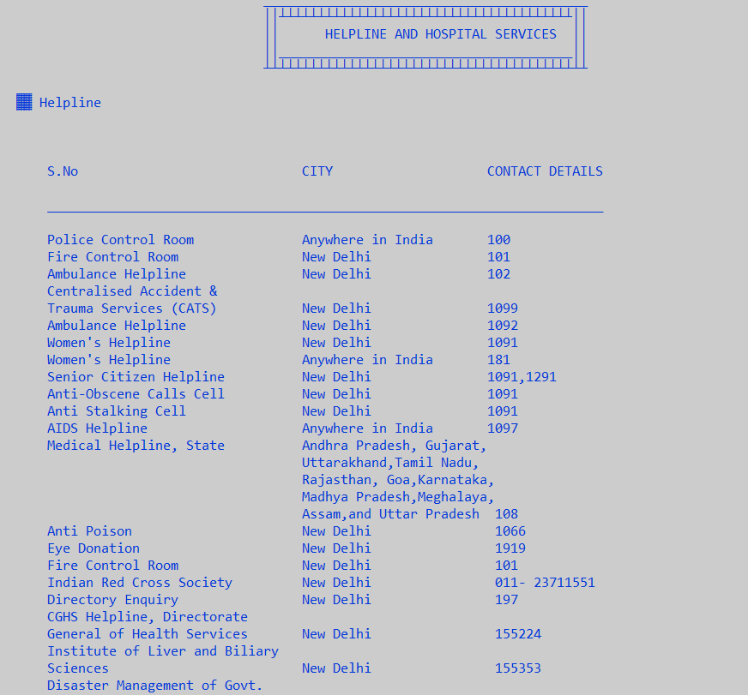
(3) Helpline :
Helpline is the 5 option of the menu of this program.
Helpline is used to create the contain all hospitals , blood banks , 24 hours ambulance ,emergency and non-emergency helpline phone numbers in our city which is very useful in the time any accident and emergency situation .

Slide 13
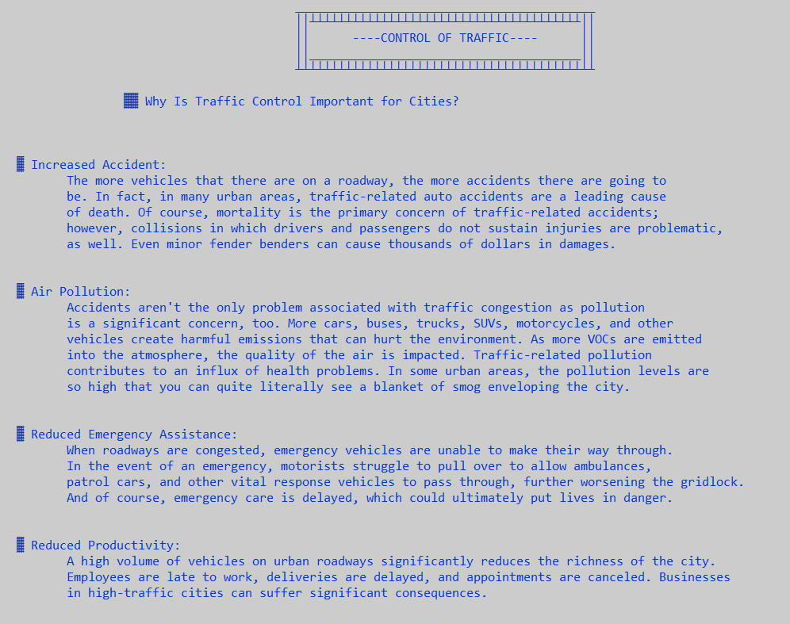
(4) Control :
Control is the 6 option of the menu of this program .
Control is used to create the contain of all rules and regulation of traffic control .And guide the peoples , why traffic control rules are important for the cities and what precautions we take in the time of emergency situation.

Slide 14
Class 3 : Vehicles
Add Record:- Add Record is the first member function of this class.
Store Record:- Store Record is the second member function of this class.
Display Record :- Display Record is the third member function of this class.
Show Record:- Show Record is the fourth member function of this class.
Update Record:- Update Record is the fifth member function of this class.
Search Record:- Search Record is the sixth member function of this class.
Delete Record:- Delete Record is the seventh member function of this class.

Slide 15
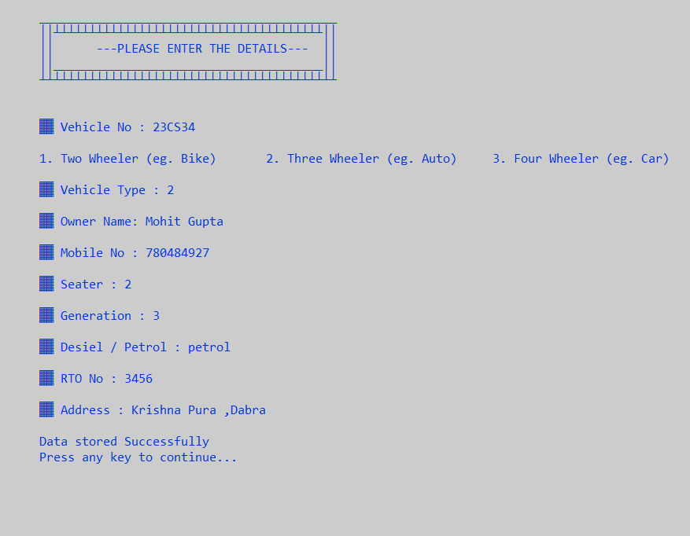
(1) Add Record :
Add record is the 1 option of vehicle menu of this progam .
Add record is used to create the design and text formatting of add record function . There is a function where we defined what our text and design look like when we dating our data of vehicles in this program.

Slide 16
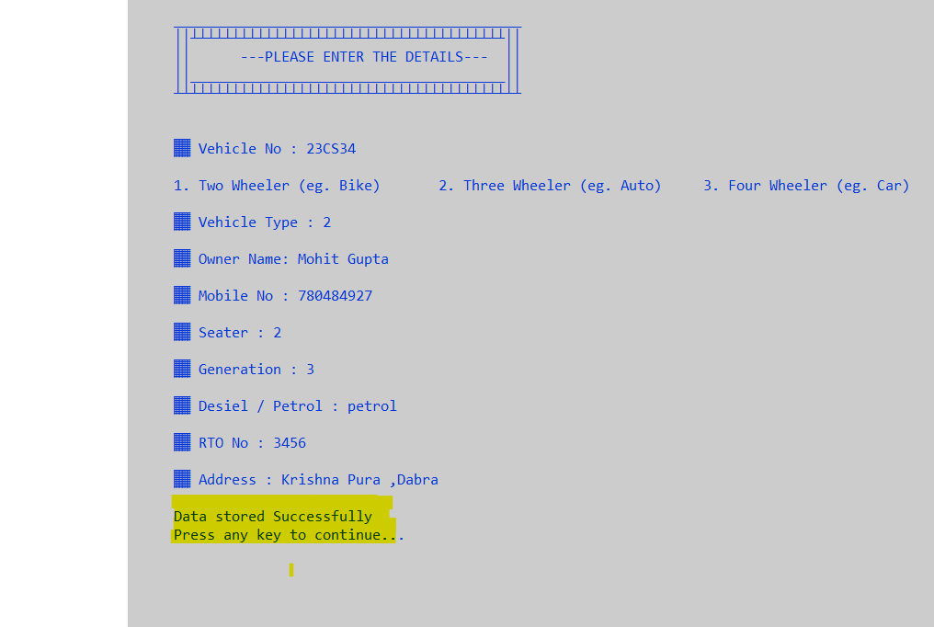
(2) Store Record :
Store record is also the 1 option of vehicle menu and works after the add record function in the same option .
Store record is used to create the store the records and information of vehicles as we can see in the screen short where all the data of a particular vehicle we text before with the help of add record function is storeded successfully in our database file of this program as we can see in the yellow box .

Slide 17
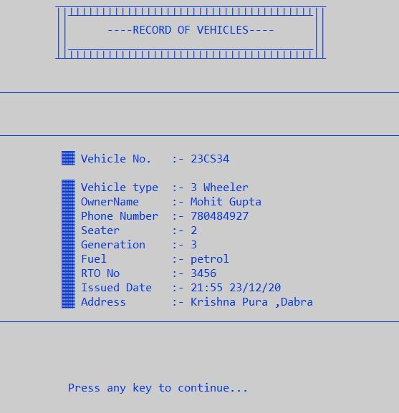
(3) Display Record :
Display function is the 2 option of the menu of this program.
Display function is used to create for showing our records and data of vehicles we stored before in the data file of this program with the help of add record and store record .

Slide 18
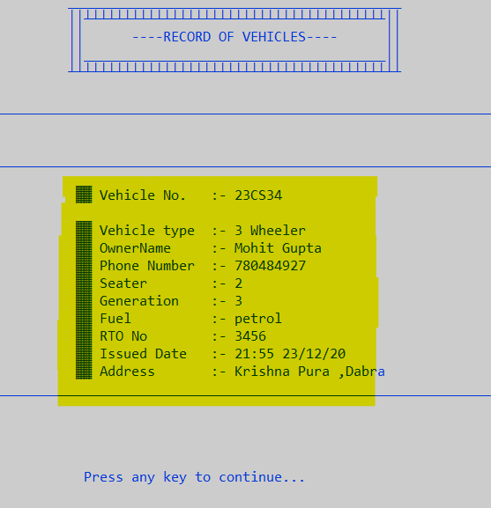
(4) Show Record :
Show record is also the 2 option of the menu and works in the display record function of this program.
Show record is used to create for showing the formate and design of the stored data where we can see whats our stored data look like when we open the 2 option of the menu as we can see in the screen short of this program in the yellow highlighted area.

Slide 19
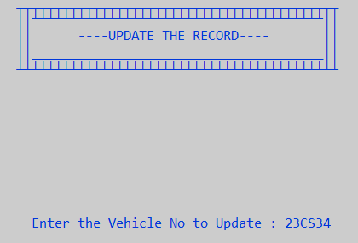
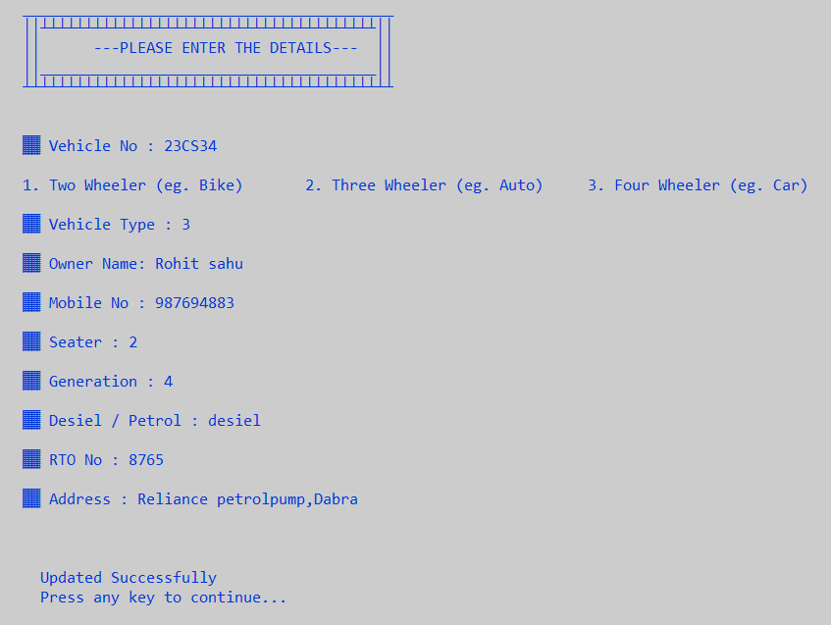
(5) Update Record :
Update record is the 3 option of the vehicle menu of this program.
Update record is used to create for update the data of any vehicle in this program as we can see in the above screen short where we type the same vehicle number we add and stored before in our previous slides next we click the enter button and update the data of any vehicle with same vehicle number as we can see in the below screen short where the new data updated successfully.

Slide 20
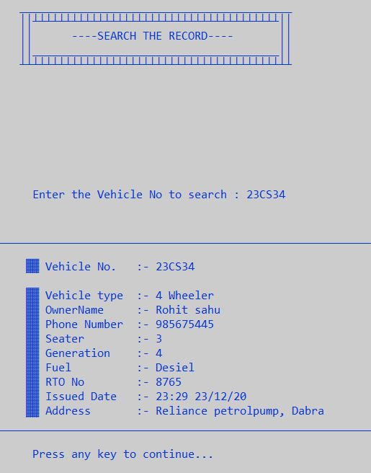
(6) Search Record :
Search record is the 3 option of the menu of this program .
Search record is used to create for search any vehicle data individually in very large database in very less time .
Firstly we enter the vehicle no which vehicle we want to find in the database of this program and after this we click enter button and our data is displayed as we can see in the screen short of this program.

Slide 21
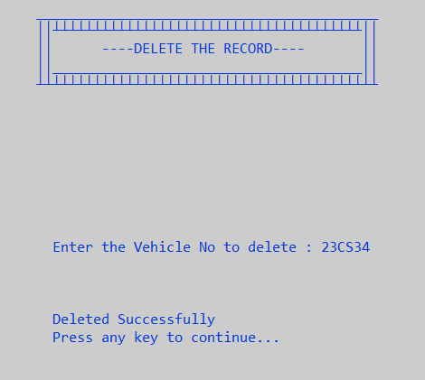
(7) Delete Record :
Delete record is the 2 option of the vehicle menu of this program.
Vehicle menu is used to create for delete any vehicle data and record which is exist in this program .
First ,we enter the vehicle number which vehicle we want to delete in the database of this program and after this we click the enter button and data of that vehicle is deleted successfully as we can see in the screen short of this program.

Slide 22

Thank you

